Slide 1
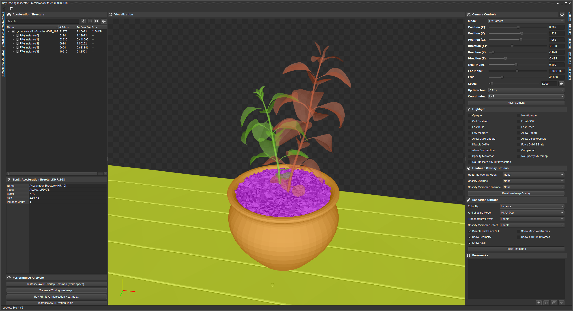
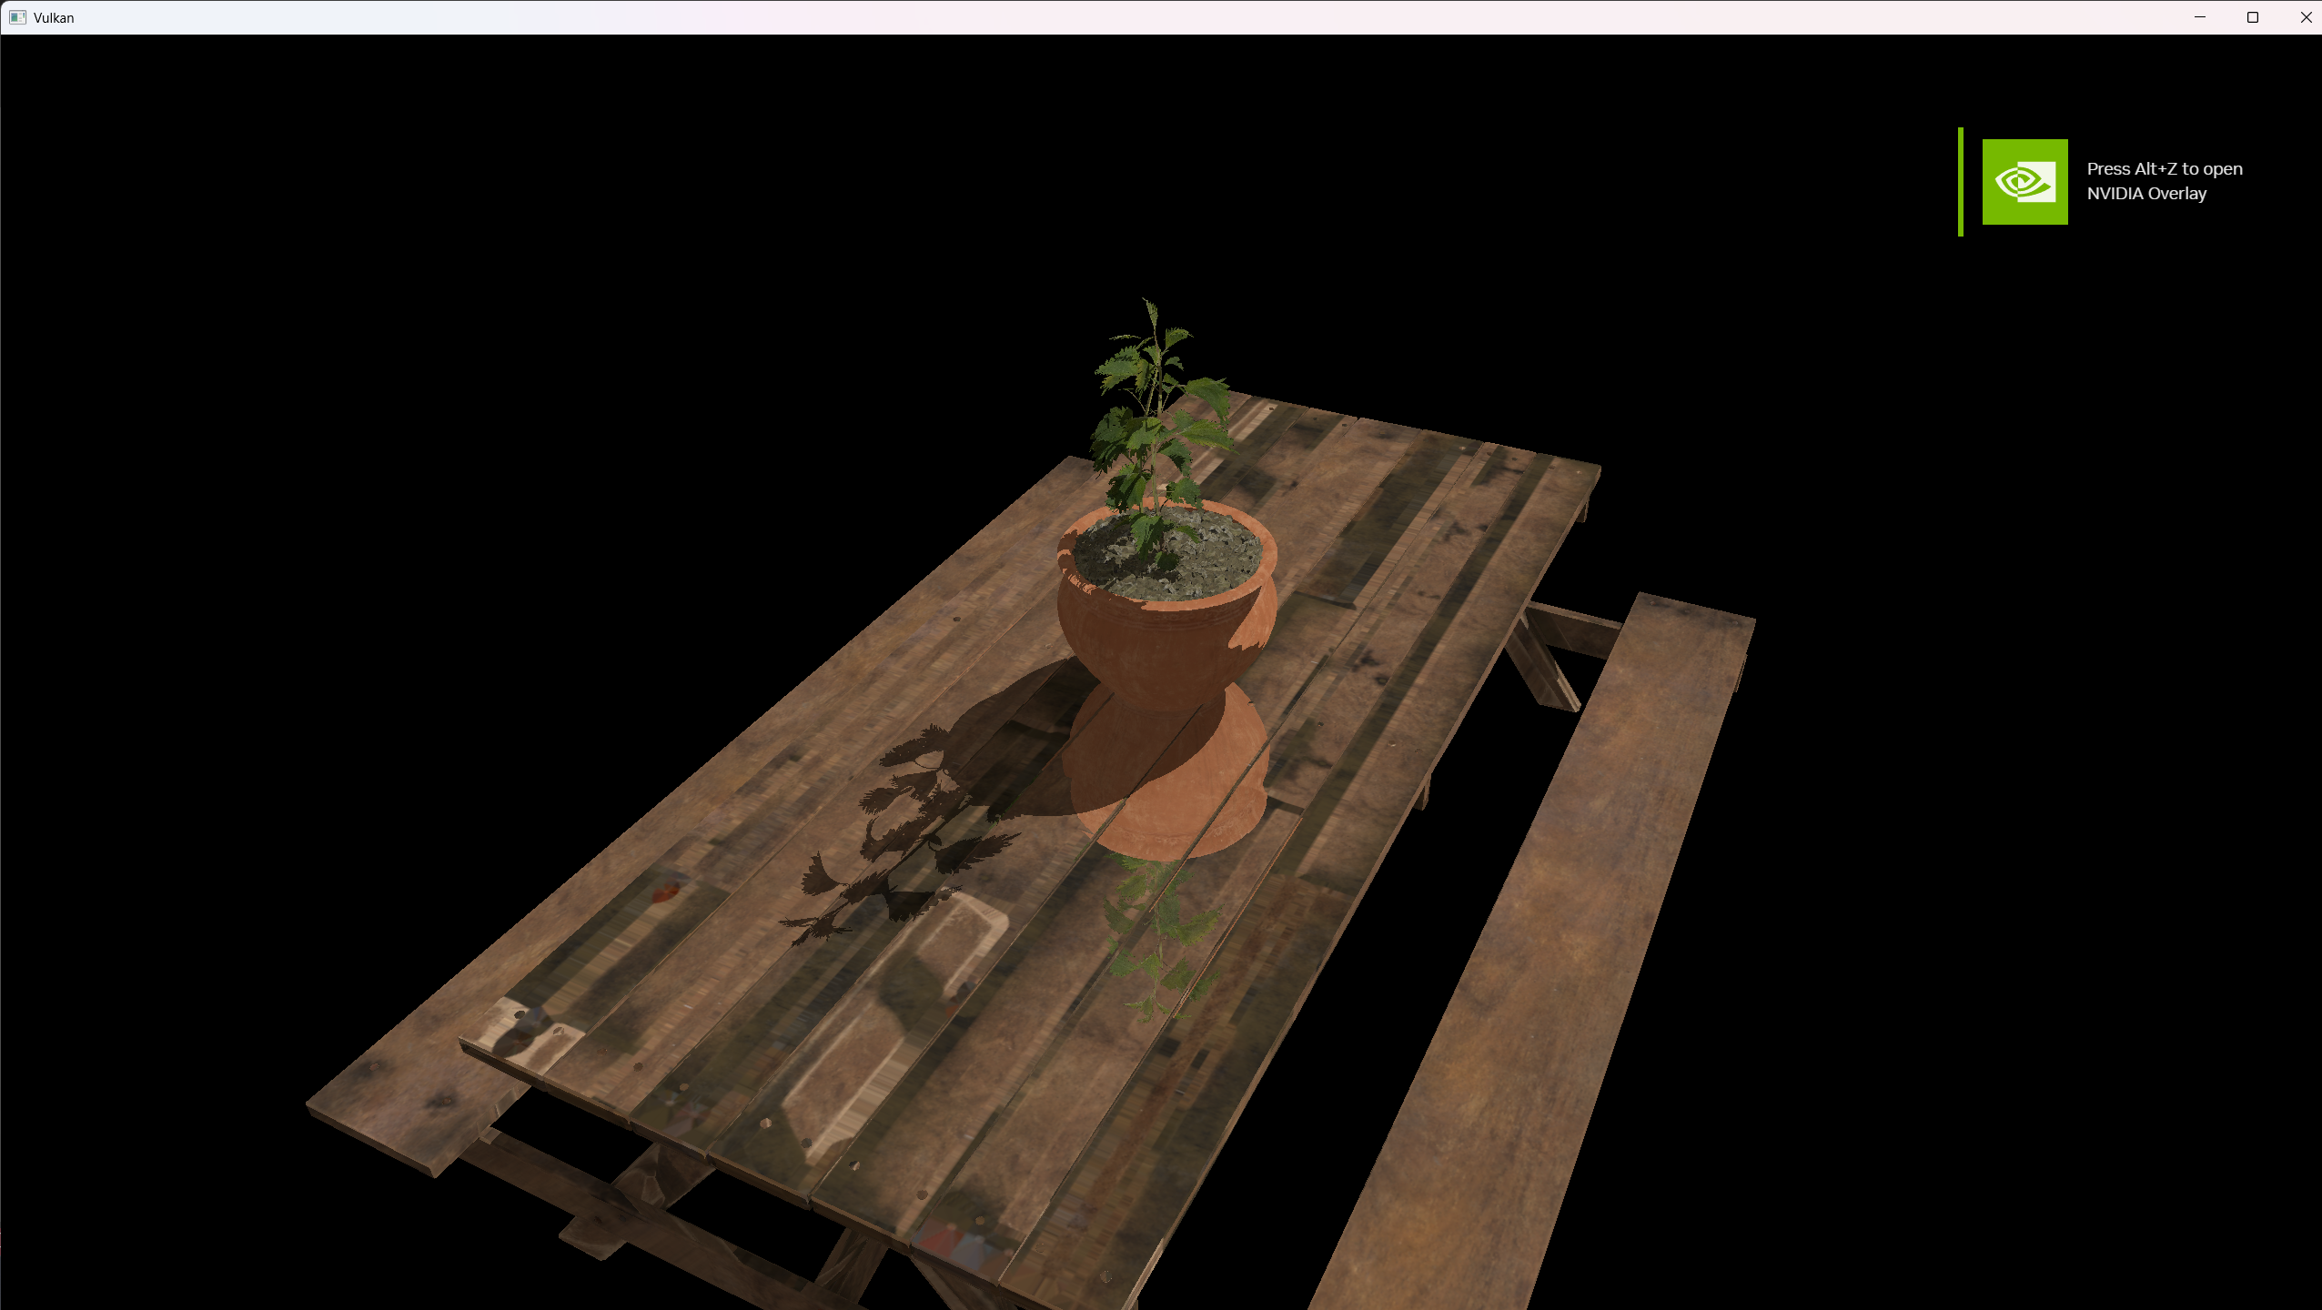

Vulkan Ray Tracing With Dynamic Rendering
Jose Emilio Munoz-Lopez (Arm)
Steve Winston (holochip)
Vulkan and the Vulkan logo are registered trademarks of the Khronos Group Inc.

Slide 2

Vulkan Tutorial
All the content will soon be available as part of Khronos’ Vulkan Tutorial
https://github.com/KhronosGroup/Vulkan-Tutorial
In the meantime, you may access the content presented today in this Pull Request
https://github.com/KhronosGroup/Vulkan-Tutorial/pull/145

Slide 3


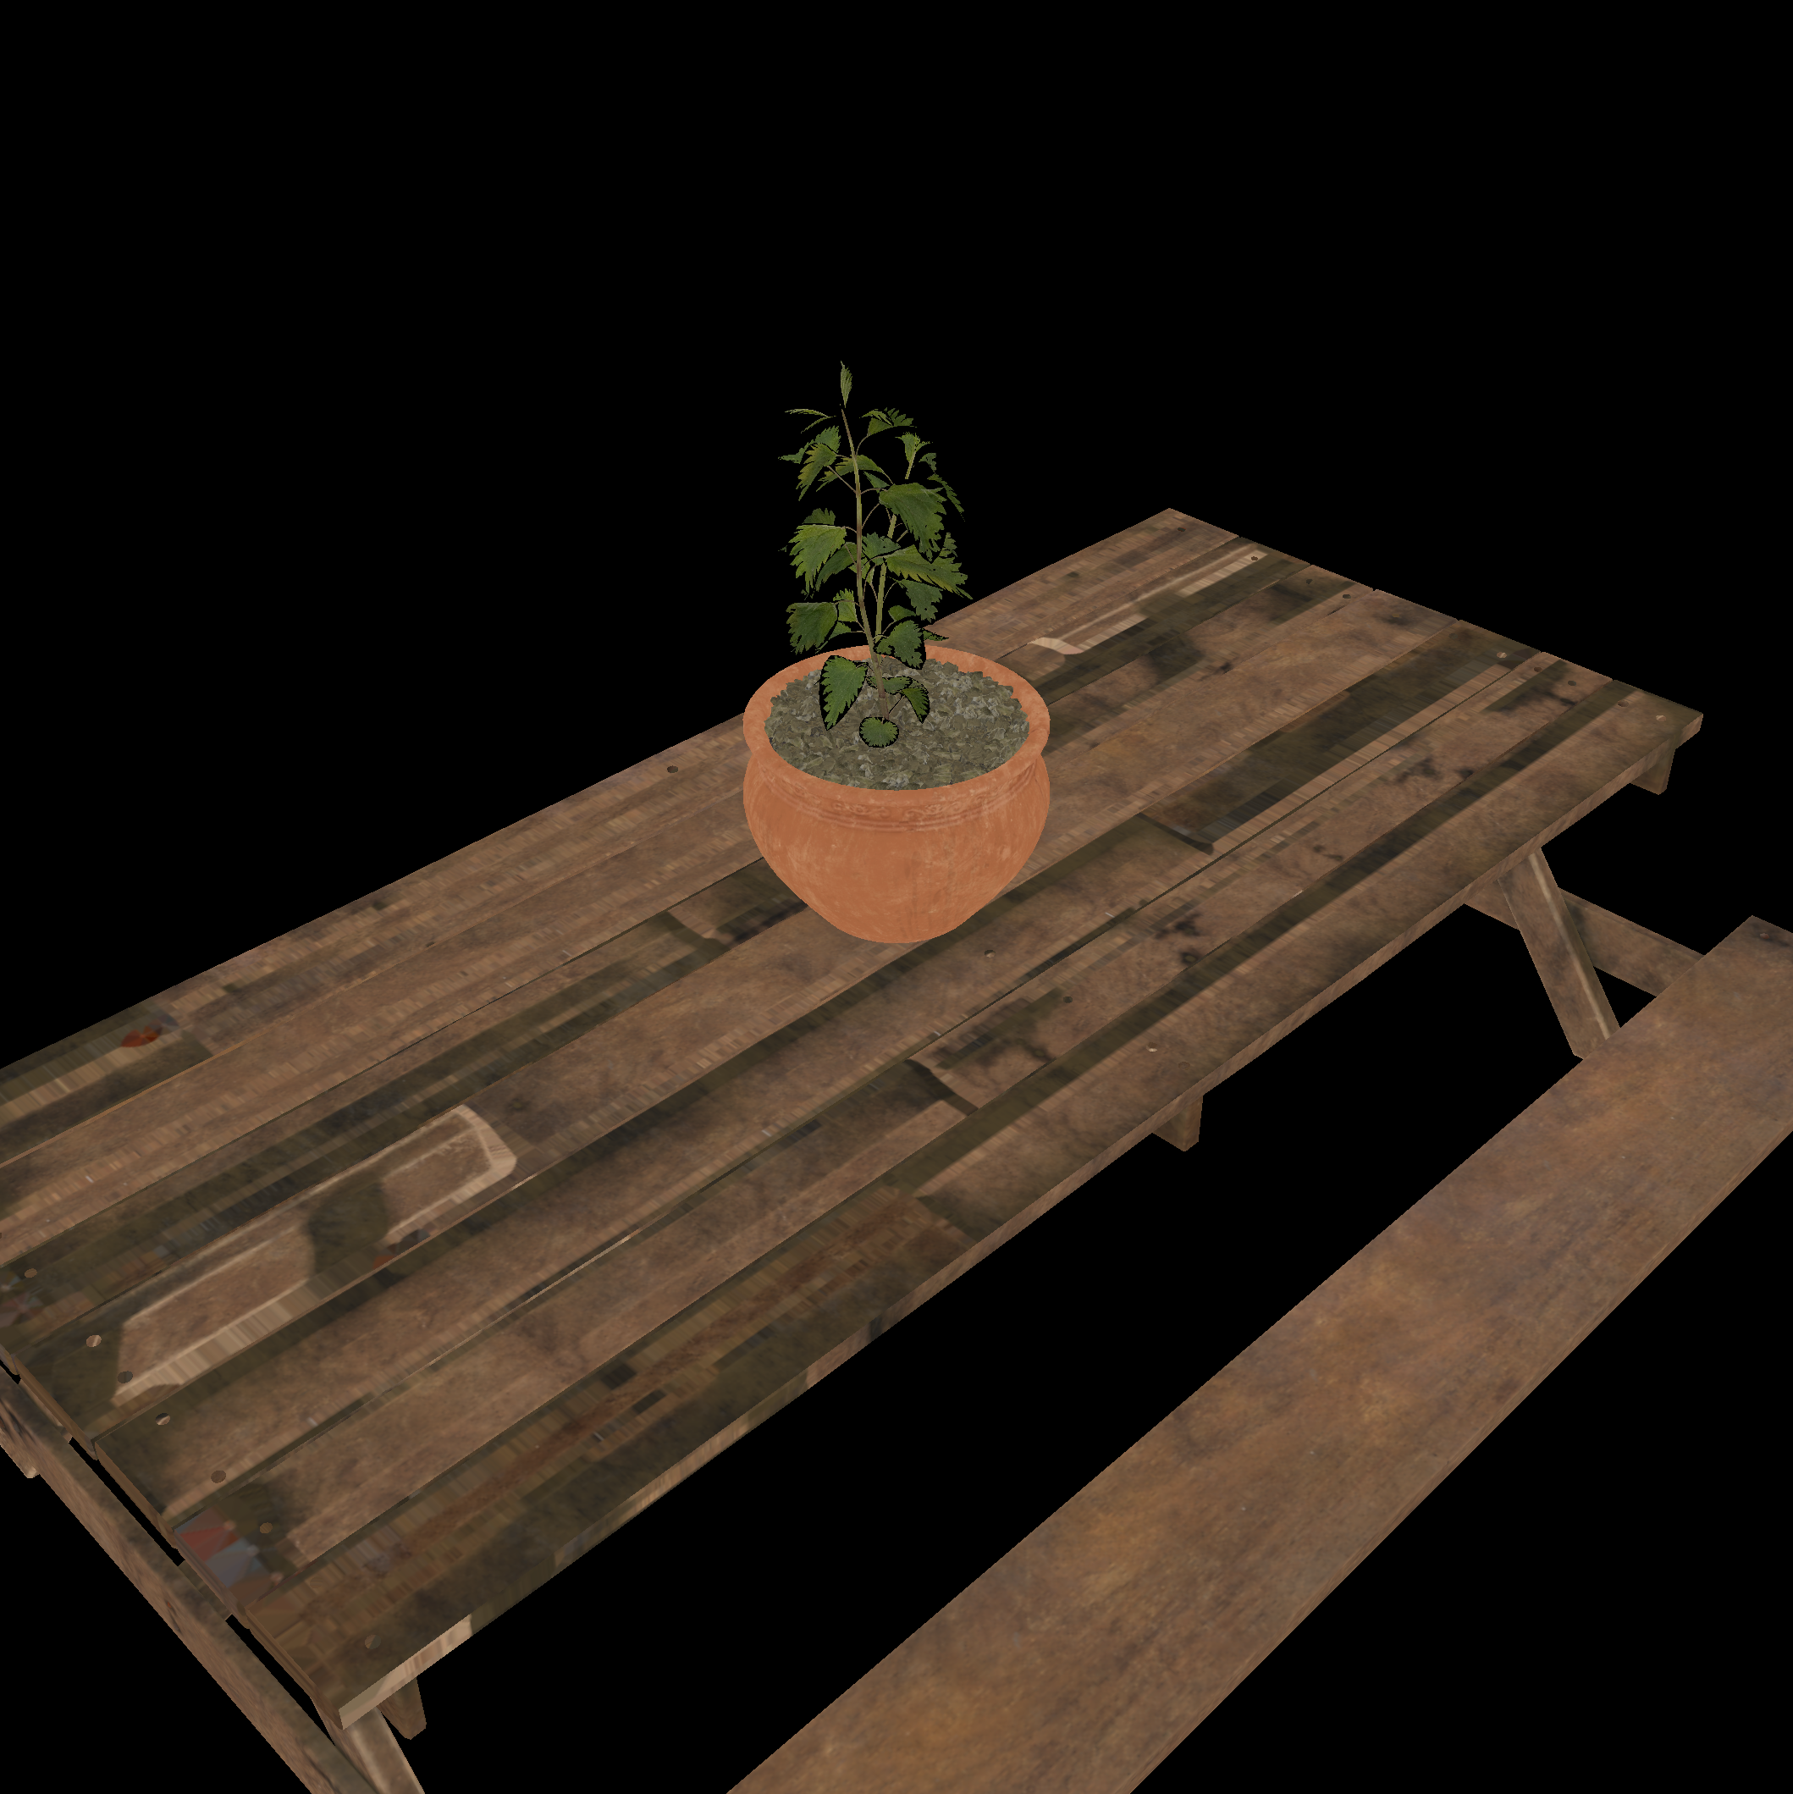
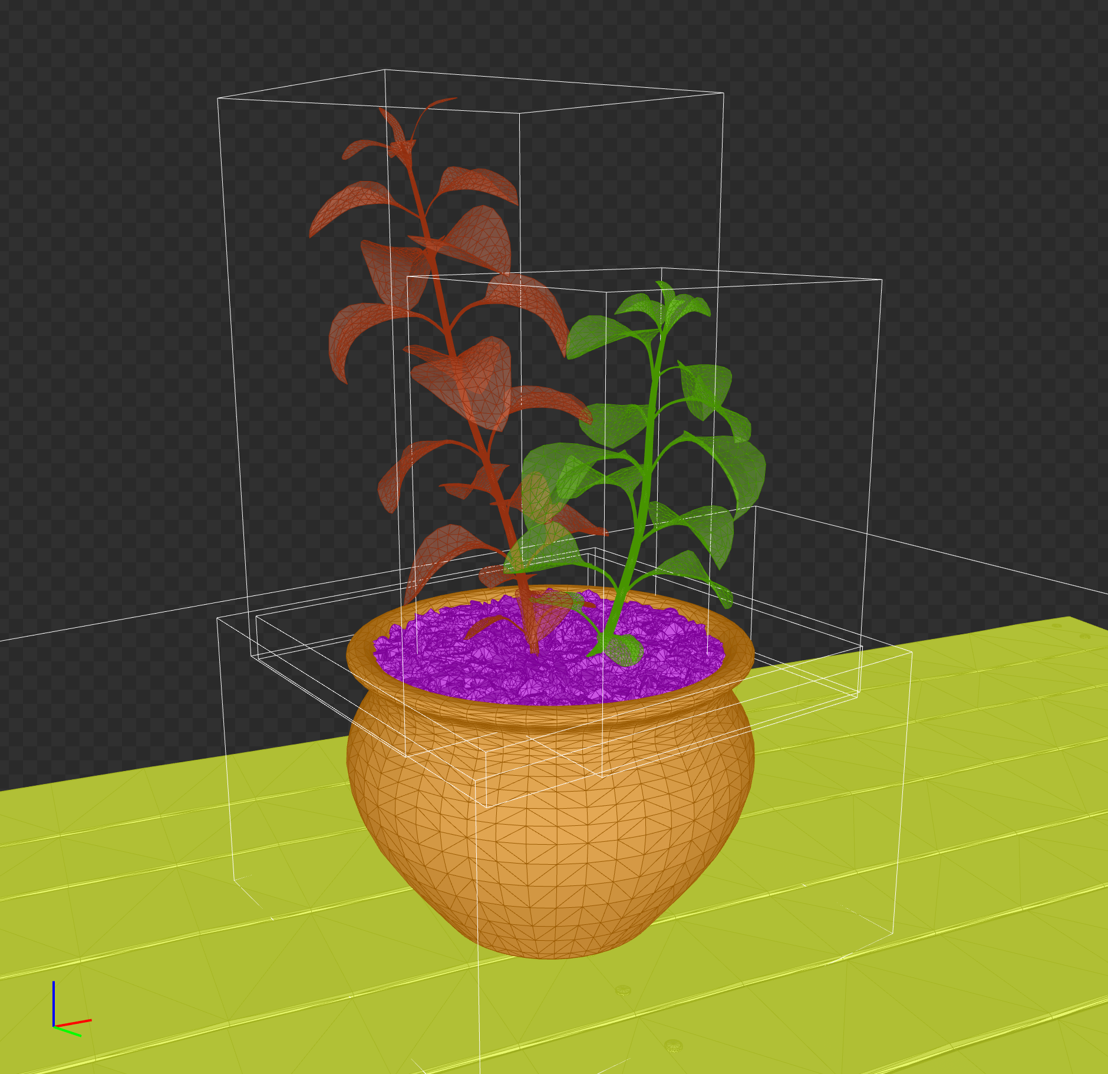
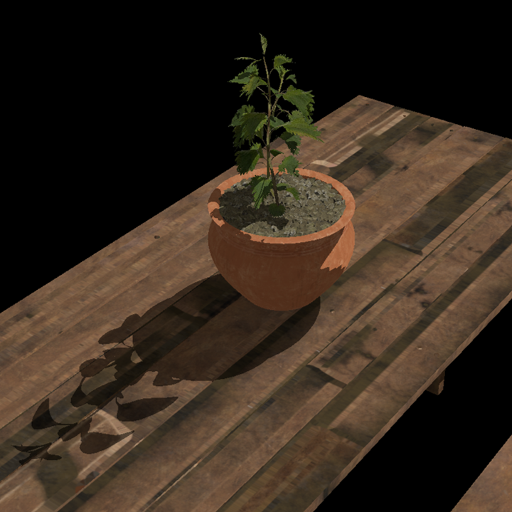
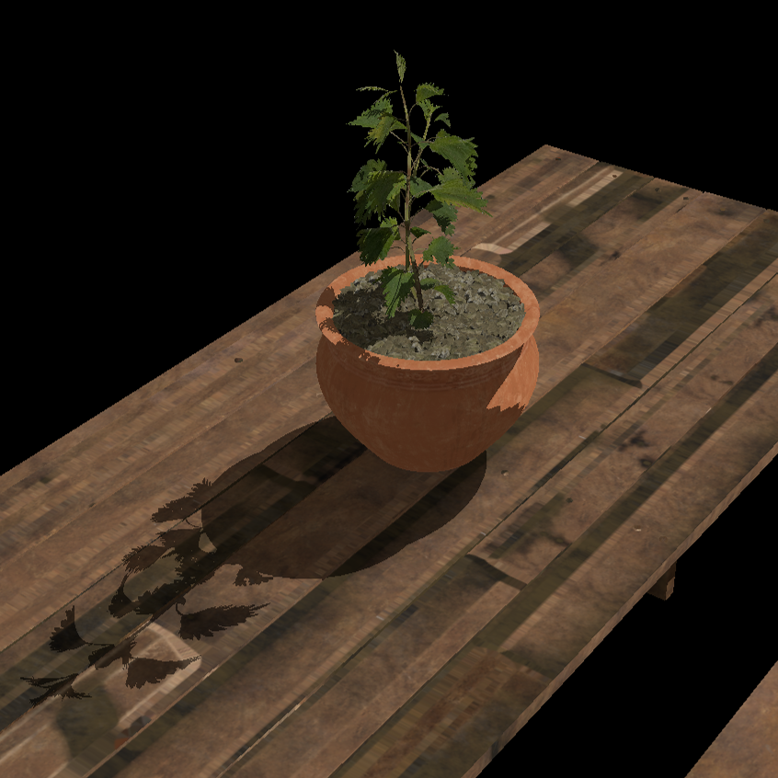
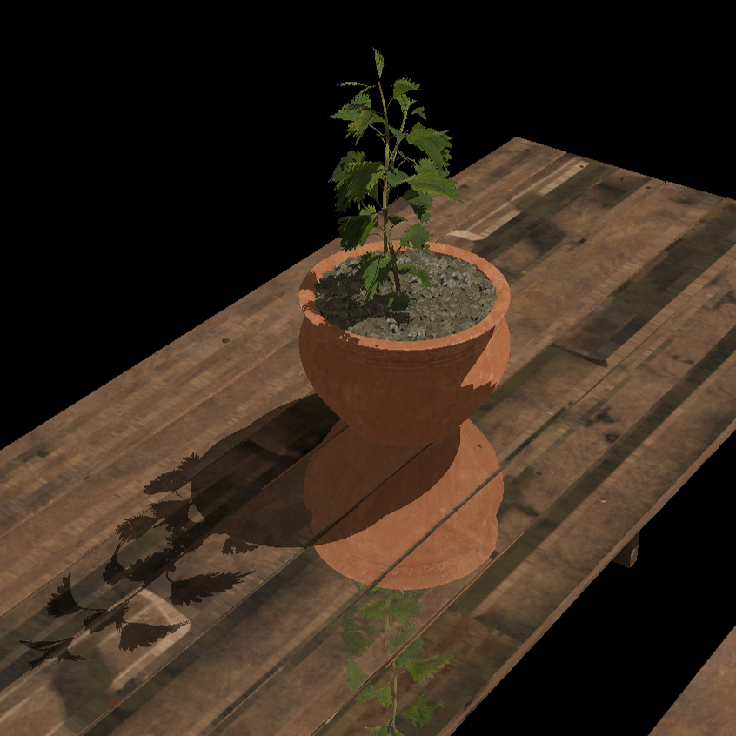
Lab Overview
attachments/38_ray_tracing.cpp
attachments/38_ray_tracing.slang
Vulkan and the Vulkan logo, Slang™ and the Slang logo are registered trademarks of the Khronos Group Inc.

Slide 4
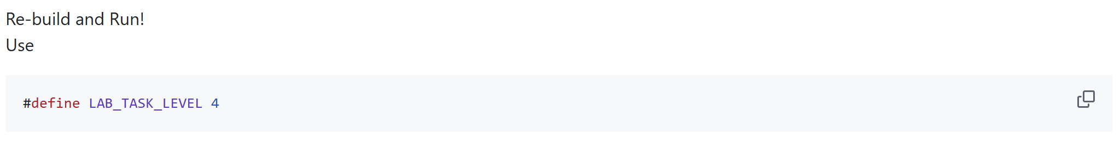
Build and Run!
cmake --build build --target 38_ray_tracing –-parallel
start .\build\38_ray_tracing\Debug\38_ray_tracing.exe -wo .\build\38_ray_tracing\
Vulkan and the Vulkan logo, Slang™ and the Slang logo are registered trademarks of the Khronos Group Inc.

Slide 5
Coding time

Slide 6
Wrap-up
Complete the full Vulkan Tutorial at https://github.com/KhronosGroup/Vulkan-Tutorial
Find more Vulkan documentation and resources at https://www.khronos.org/vulkan
Read Arm’s Vulkan Best Practice guide at https://developer.arm.com/mobile-graphics-and-gaming/vulkan-api-best-practices-on-arm-gpus
Download RenderDoc at https://github.com/baldurk/renderdoc
Download NVIDIA Nsight Graphics at https://developer.nvidia.com/nsight-graphics
Learn more about the Slang shading language at https://shader-slang.org

Slide 7
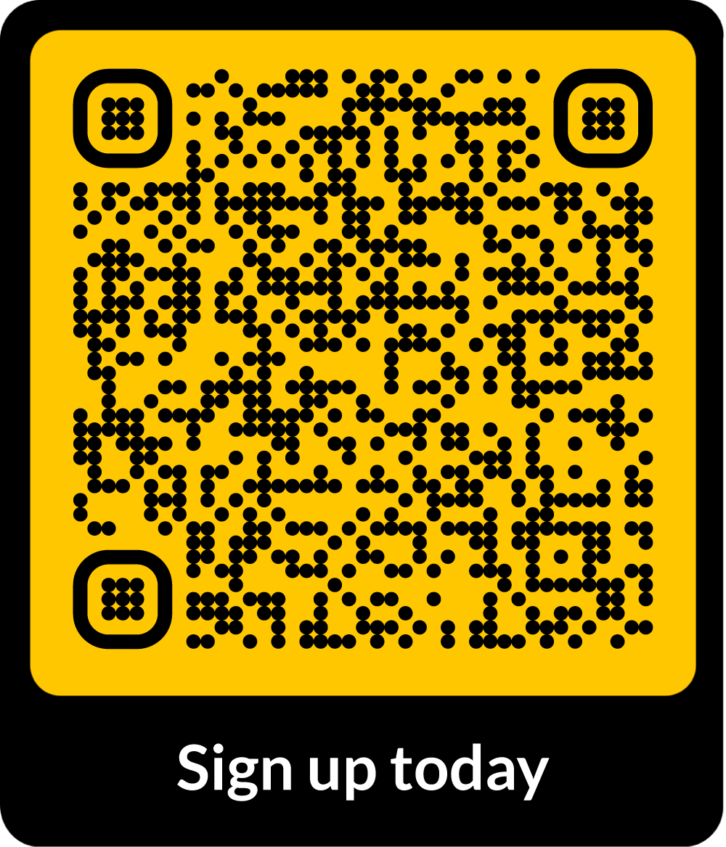
The community to build your future on Arm
Discord | ArmSoftwareDev
Twitter | @ArmSoftwareDev
YouTube | @ArmSoftwareDevelopers
Get fresh insights directly from Arm experts
Connect with like-minded developers
Build on your expertise and become an Arm Ambassador
There is something for everyone in our global community
arm.com/developerprogram

Slide 8
Thank you!

